Slide 1
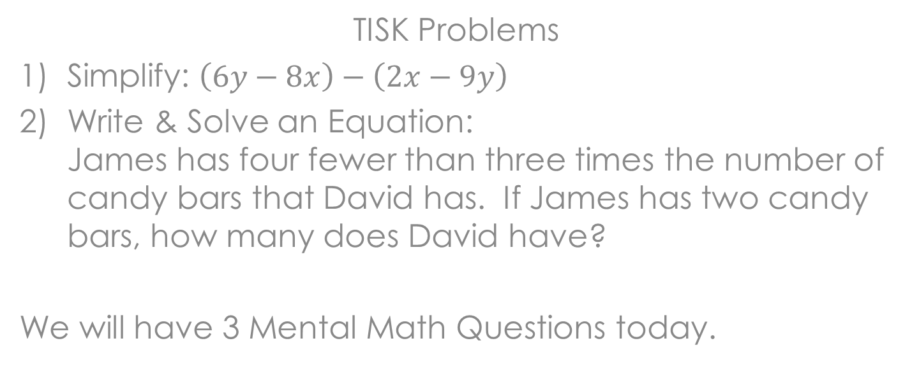
Wednesday, September 19, 2012
TISK Problems
Simplify: $\left(6y−8x\right)−\left(2x−9y\right)$
Write & Solve an Equation:
James has four fewer than three times the number of candy bars that David has. If James has two candy bars, how many does David have?
We will have 3 Mental Math Questions today.
HOMEWORK: p. 422 #21-30
Notes:
Mental Math
Add 38 and 52. Subtract 44. Add 78. Divide by 4. (31)
Add 46 and 34. Subtract 57. Add 99. Divide by 2. (61)
Add 19 and 41. Subtract 23. Add 131. Divide by 8. (21)

Slide 2
Homework Check
17) 23% decrease
19) 30% decrease
21) 17% decrease
23) $600
25) 200
27) 50
29) The price decreased by about 40%.

Slide 3
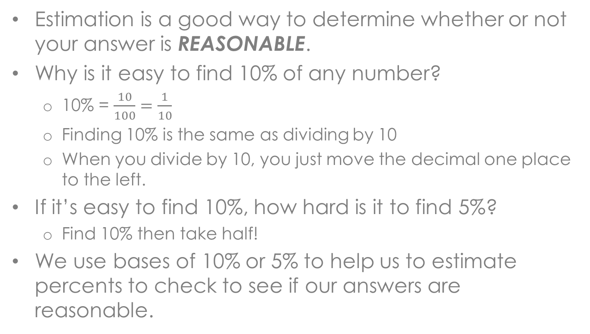
§8-5 Estimating with Percents
Estimation is a good way to determine whether or not your answer is REASONABLE.
Why is it easy to find 10% of any number?
  10% = $\frac{10}{100}=\frac{1}{10}$
  Finding 10% is the same as dividing by 10
  When you divide by 10, you just move the decimal one place to the left.
If it’s easy to find 10%, how hard is it to find 5%?
  Find 10% then take half!
We use bases of 10% or 5% to help us to estimate percents to check to see if our answers are reasonable.

Slide 4
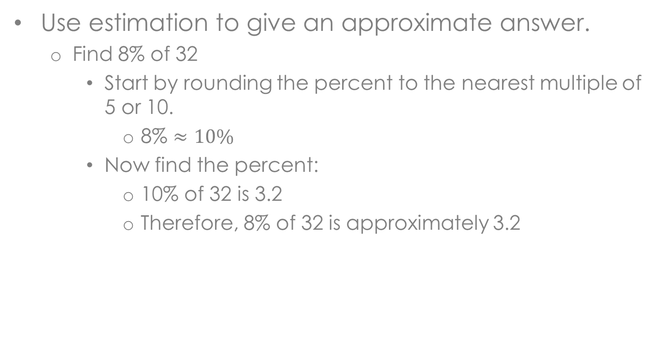
Example
Use estimation to give an approximate answer.
  Find 8% of 32
    Start by rounding the percent to the nearest multiple of 5 or 10.
      8% $≈10\%$
    Now find the percent:
      10% of 32 is 3.2
      Therefore, 8% of 32 is approximately 3.2

Slide 5
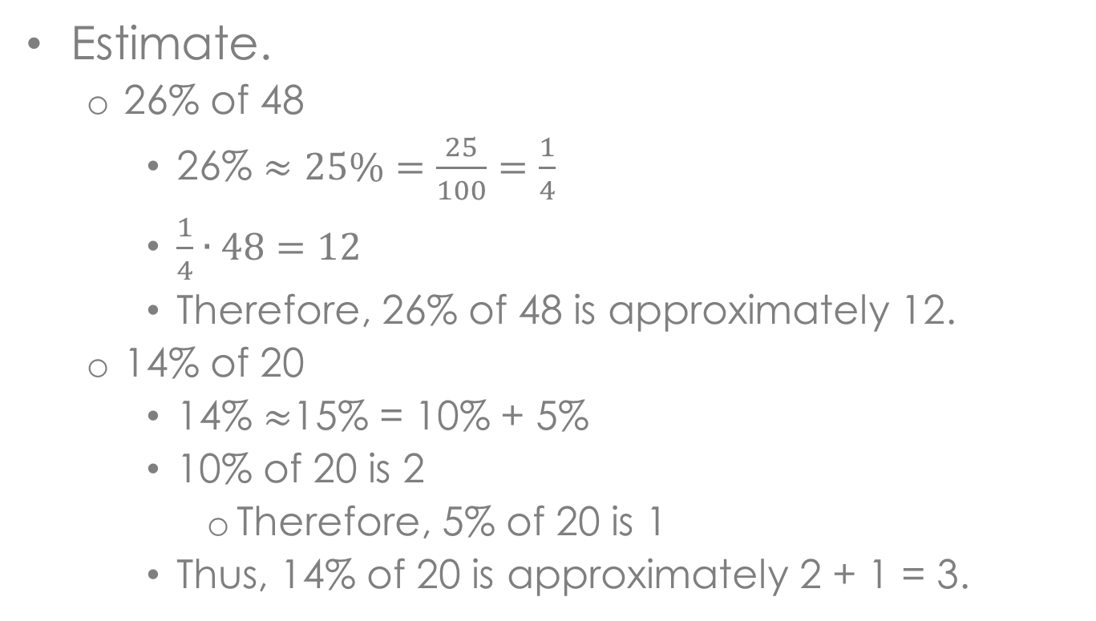
Example
Estimate.
  26% of 48
    26% $≈25\%=\frac{25}{100}=\frac{1}{4}$
    $\frac{1}{4}∙48=12$
    Therefore, 26% of 48 is approximately 12.
  14% of 20
    14% $≈$15% = 10% + 5%
    10% of 20 is 2
      Therefore, 5% of 20 is 1
    Thus, 14% of 20 is approximately 2 + 1 = 3.

Slide 6
Example
The diameter of the Moon is about 2160 miles. If the diameter of the Moon is about 27% of the diameter of the Earth, what is the approximate diameter of Earth?
These words all imply that the answer we are looking for does not need to be exact.
In other words, the question is telling us to use rounding and estimation!

Slide 7






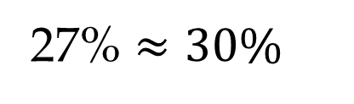
Example
The diameter of the Moon is about 2160 miles. If the diameter of the Moon is about 27% of the diameter of the Earth, what is the approximate diameter of Earth?
Change to a percent question.
Two thousand one hundred sixty is
27% of
what number?
Write a percent equation.
2160
=
27%
$$∙$$
$$e$$
Estimate.
$$2160≈30\%e$$
$$720≈10\%e$$
27% $≈30\%$
$$2160÷3=720$$
$$7200≈e$$
Earth is approximately 7,200 miles in diameter.

Slide 8
Check Point
Estimate.
  21% of 66
  36% of 120
A normal tip is 15%-20%. What would be a normal tip on a $24.89 bill?

Slide 9
Discuss
How could you find 35% of a number if you knew what 10% of that number was?

Slide 10
Homework
p. 422 #21-30

